Slide 1
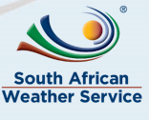
The Global Observation System for Mercury (GOS⁴M) a GEO Flagship Program
Lynwill G Martin
South African Weather Service (SAWS)

Slide 2
Introduction: What is GOS⁴M
Flagship Program (GEO BON, GEOGLAM, GFOI, GOS⁴M)
Integrates several operational networks into one large infrastructure
A coordinated global network for collecting environmental information on mercury
The network enables the gathering and availability of data to one central platform
Disseminate comparable data for anyone
On line model functions provide scenarios to respond to science/policy questions
GEO Flagships:
GEO Flagships are Initiatives that exemplify the kind of impact and support to global, national, and local decision making that GEO aims to encourage and replicate.
Programmehttps://earthobservations.org/documents/gwp20_22/gwp2020_summary_document.pdf

Slide 3
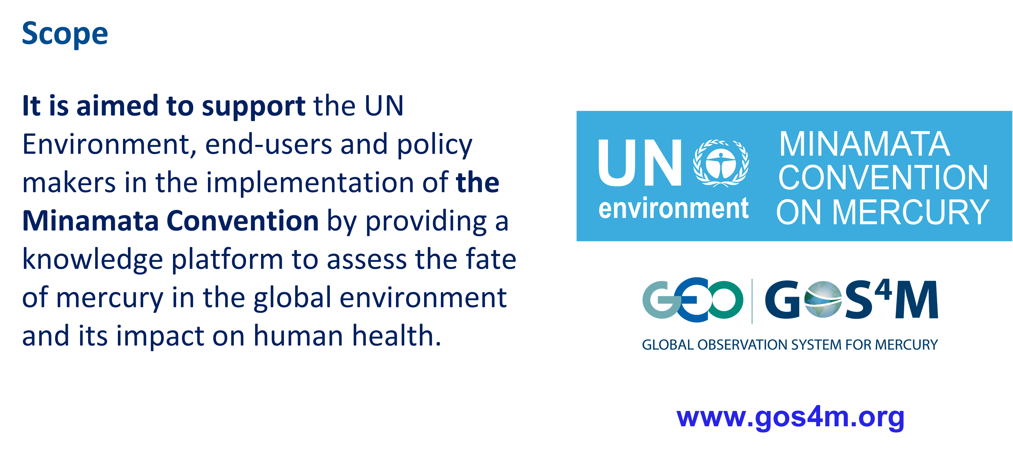
Objectives of GOS4M

Slide 4
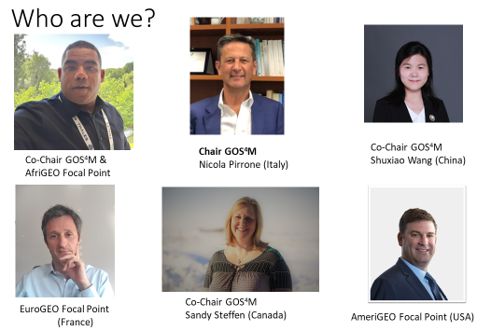
Introduction

Slide 5
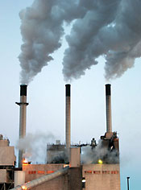
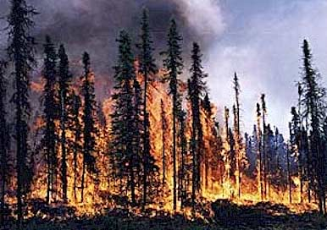

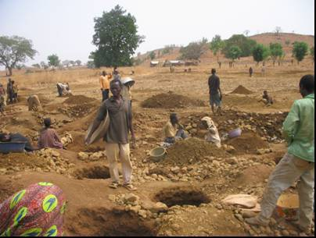
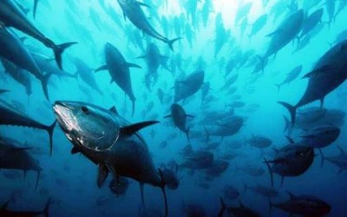
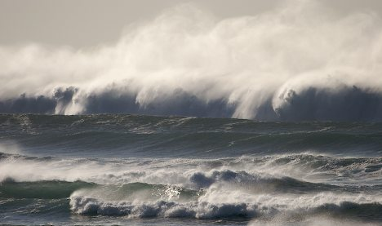
So What is the Issue?
Mercury has a long lifetime in the air
Mercury is a global pollutant
  Bioaccumulative
  Neurotoxin
Natural, anthropogenic re-emitted
Anthropogenic
Global treaty for mercury reduction
  Minamata Convention on Mercury
  Need for global monitoring and applied modelling

Slide 6
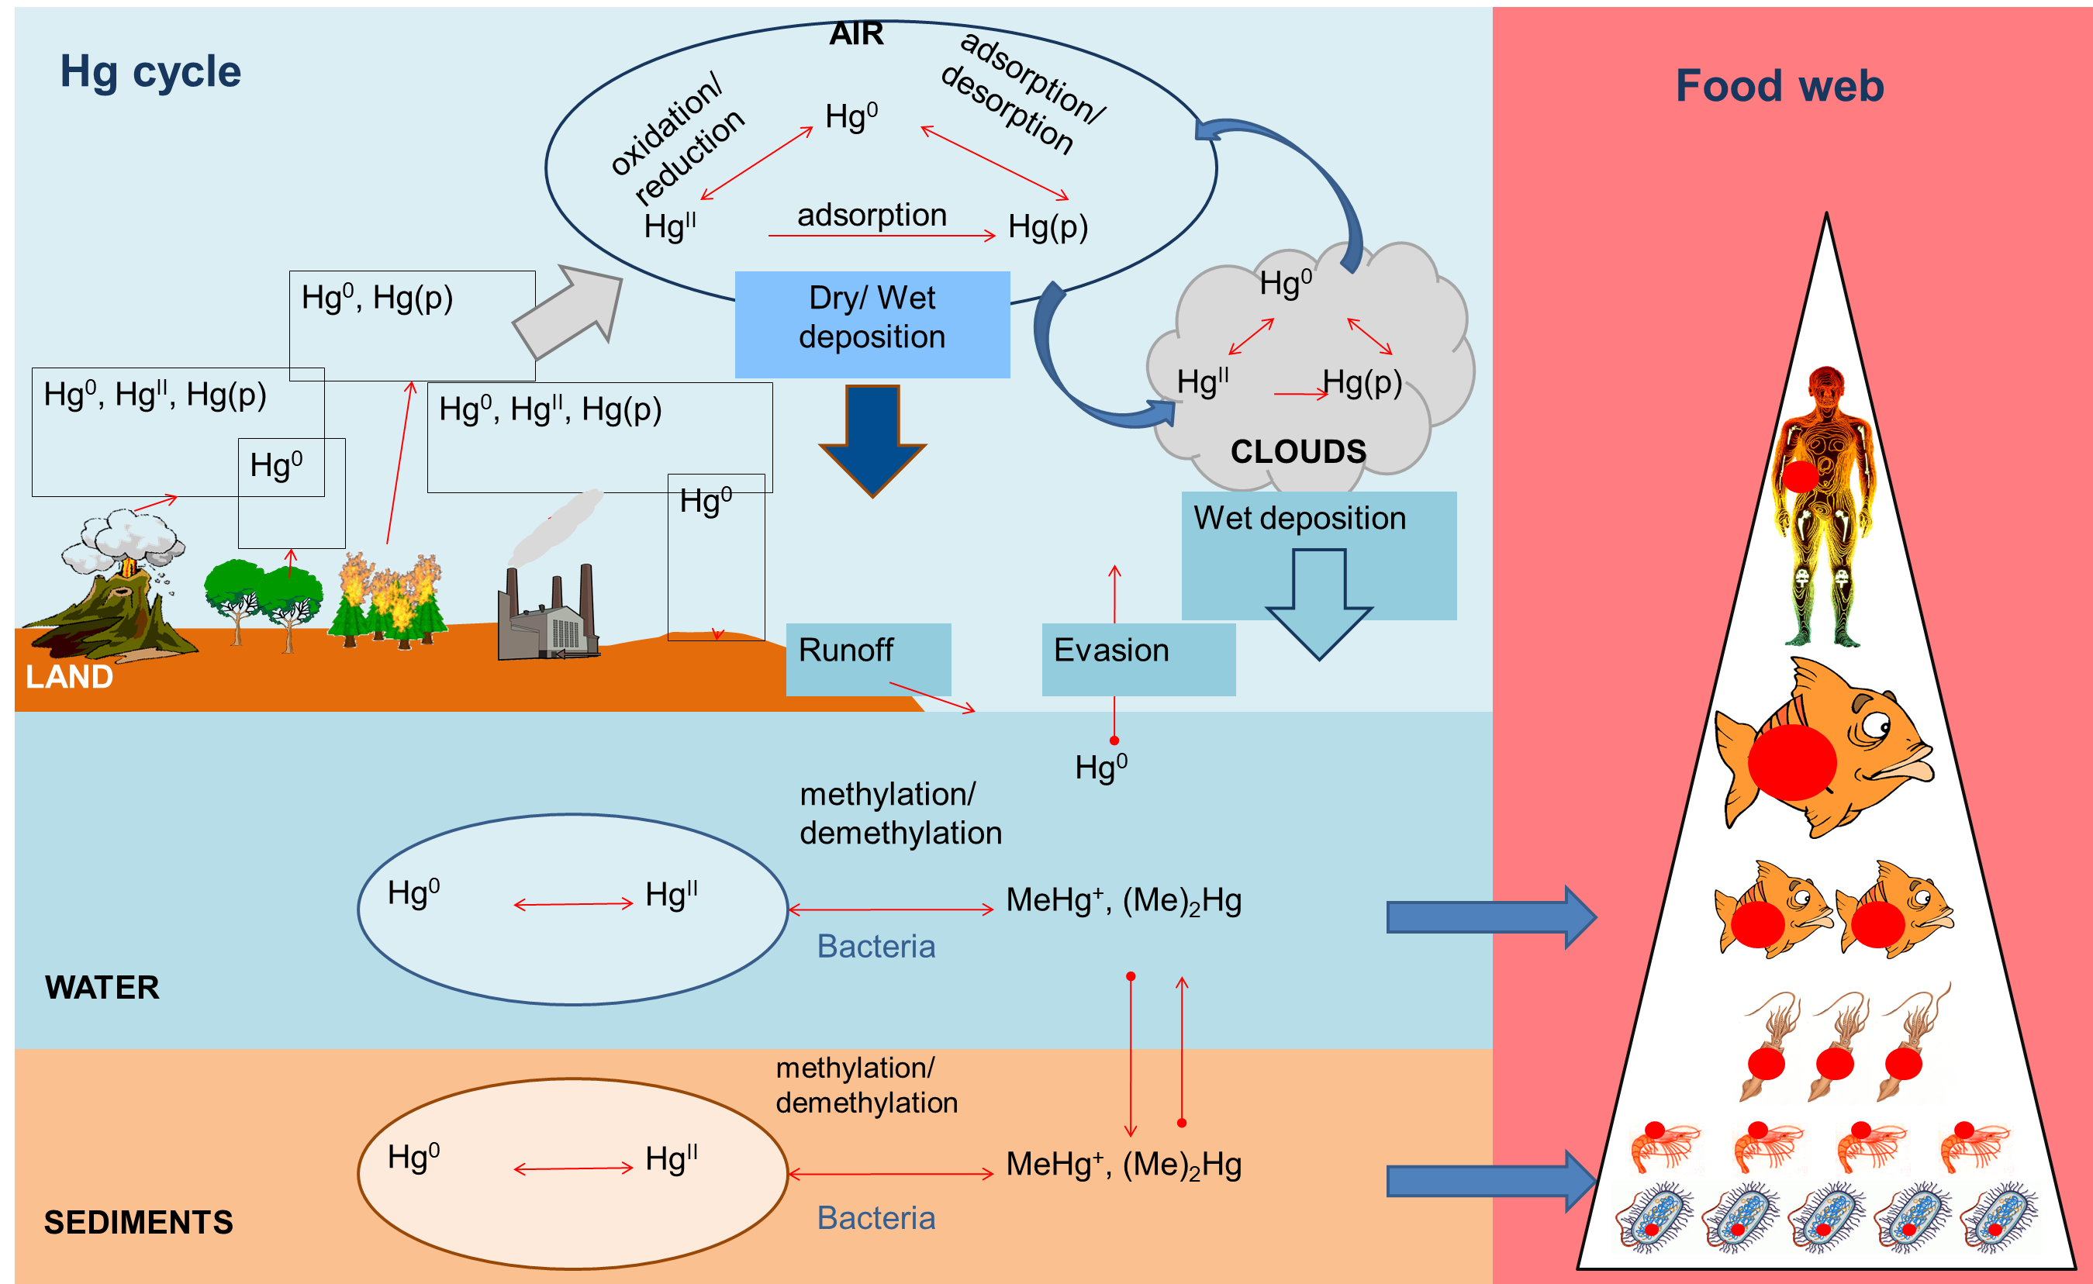
So What is the Issue? Here is the ISSUE

Slide 7
From Observations to Knowledge
Knowledge collection
Knowledge Formalization
Knowledge Sharing
Knowledge Use
Knowledge Generation
Data Compilation
Meta data and documentation
Data and output downloads
End User
Model simulations
Products for policy questions
Decision maker

Slide 8
Air Observations: Network of Networks
Global Passives
ECCC-AMM
APMMN
GOS4M
GMOS
SAMNet
CAMM
NADP
Others

Slide 9
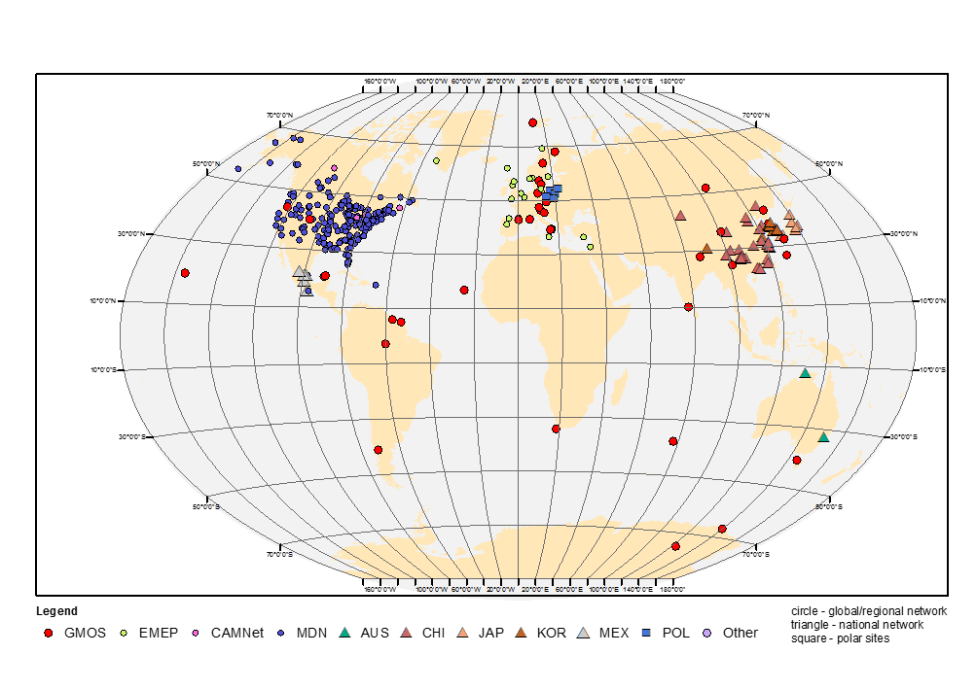
Situation for many years
Global Mercury Assessment 2018
This is all the work that has been done over time but does not represent what is happening now
Monitoring in Africa still lacking yet Africa is the continent with the most countries that ratified the Minamata Convention 37 countries.

Slide 10

South African Mercury Network (SAMNet)
SAMNet is a Department of Science & Innovation (DSI-SA) funded Project
Goal is to develop a coordinated SA (later in Africa through Afri-GEO) observation network for mercury to determine the status/trends of atmospheric mercury
Provide high quality data for the validation model input;
Assist partners in developing their mercury monitoring capacity (training)
Give government and relevant stakeholders a firm basis for future policy developments in the implementation of the Minamata Convention

Slide 11
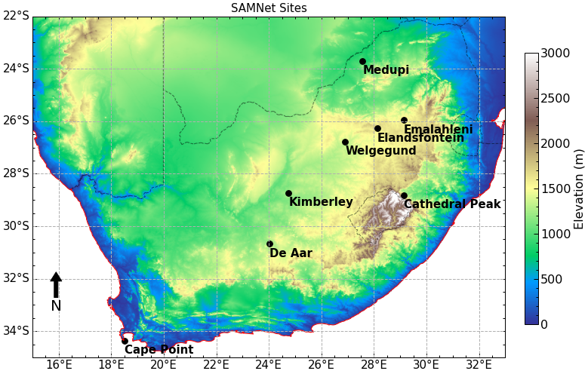
SAMNet a DSI Funded Project 2020 - 2022
•1x Cape Point continues Hg monitoring to:
3 new sites: De Aar,
Welgegund Emalahleni
•9 Passive Sampling Sites (across the country)
•3 Passive sites collaborating with ECCC
•4 Wet deposition sites
Hg Speciation Monitoring started May 2022
Springbok

Slide 12

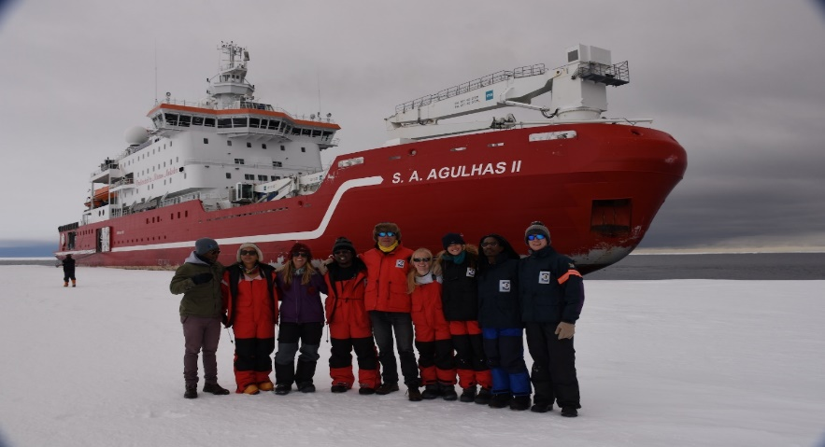
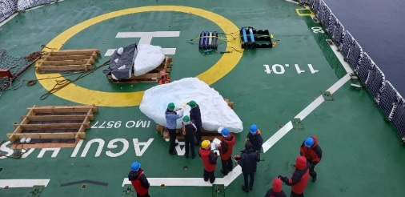
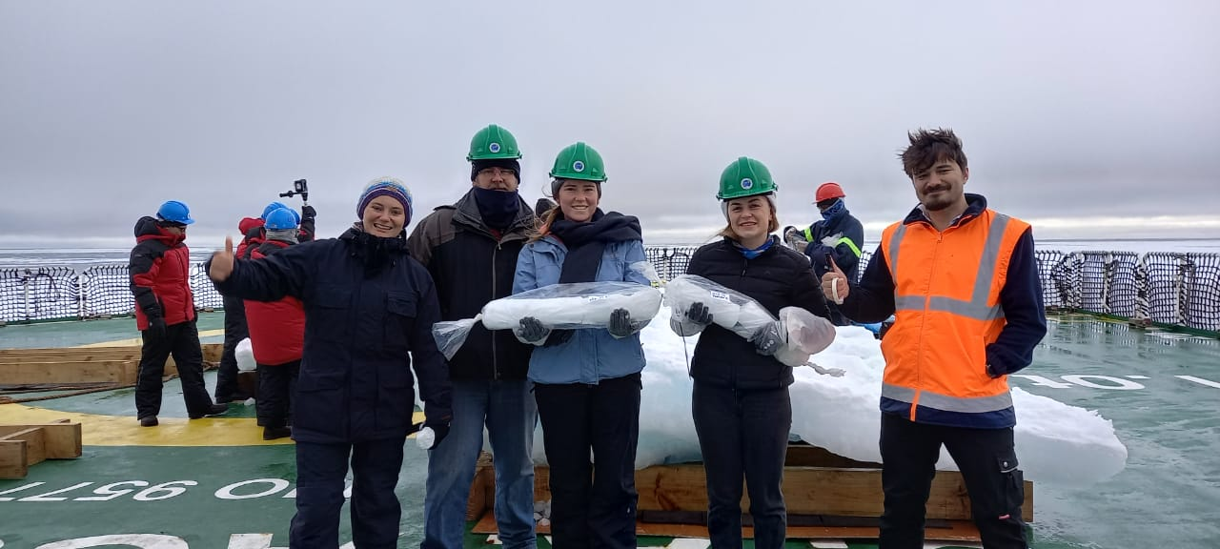
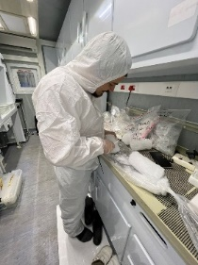
Mercury Observations over the Southern Ocean along the Cape GoodHope transect
SA National Antarctic Program (SANAP)
Southern Ocean SeAsonaL Experiment (SCALE)
Scientific Cruises planned in 2023
Hg Observations in the Southern Ocean on-board the SA Agulhas II RV 11- 31 July 2022

Slide 13
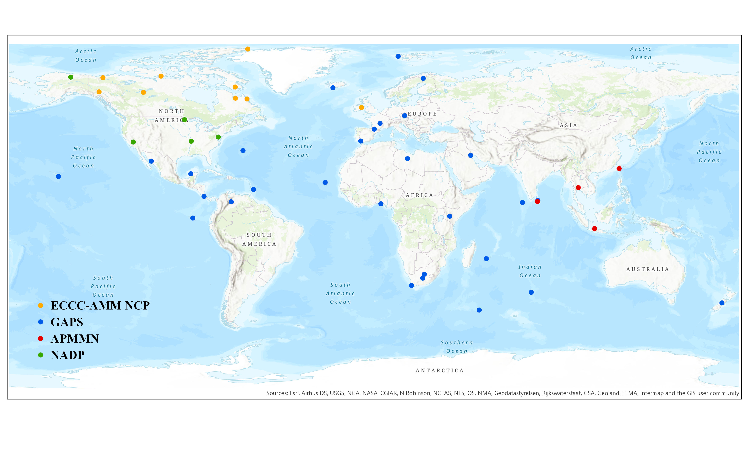
Mercury Global Passive Network
The Challenge in Africa is BIG…..but
Started 1 July
Berg Aukas | Namibia
Grootfontein | Namibia
Sunyani | Ghana
Kenyase | Ghana
Springbok | South Africa
Palapye | Botswana
Machakos | Kenya
Okavango | Botswana
Morogoro | TANZANIA

Slide 14

What can we do with Hg Air data?
Increase data accessibility
Identify data gaps, strengths and weaknesses of current systems
Plan new tools to enhance monitoring based on gaps
Promote collaboration between science and policy through an extensive outreach activities
Provide a platform to develop products to support science questions
Provide a platform to develop products to support policy questions

Slide 15
MY AFRICAN DREAM
GOS⁴M-GEO Flagship Program
Supports the Minamata Convention
Data Hub for Mercury
African Mercury Network
Coordinated Continental Mercury Network
SA Mercury Network
(SAMNet)
N-Africa
E-Africa
W-Africa

Slide 16
TAKE HOME MESSAGE:
New monitoring/research activities is ongoing in AFRICA and it’s encouraging to see but….
Need to Improve the monitoring capability of countries in Africa we need data
Filling in the Gaps will place us in a position to have a better continental view
Research should LEAD Policy making/decision (Monika Stankiewicz: Exec Sec MCM)
Need to work closer together with Minamata Focal Points/Bureau/AFRI-GEO members
There’s a need for a AFRCIAN Mercury Scientific Experts Group that can meet regularly
Write joint SIP Proposals for Africa related to improving Monitoring/Observations/Modeling

Slide 17










SAMNet Stakeholders & Funders

Slide 18
Thank you
Questions?

